Slide 1
Dhcp,vlan,cam

Slide 2





ARP Spoofing
IP: 192.168.1.23
IP: 192.168.1.1
MAC AA:AA:AA:AA:AA:AA
MAC BB:BB:BB:BB:BB:BB
The Address Resolution Protocol is a communication protocol used for discovering the link layer address, such as a MAC address, associated with a given internet layer address, typically an IPv4 address.
WHO POISON IP TABLE
IP: 192.168.1.37
MAC CC:CC:CC:CC:CC:CC
IP: 192.168.1.23
Data link layer
IP: 192.168.1.1
IP: 192.168.1.23
IP: 192.168.1.1
MAC AA:AA:AA:AA:AA:AA
MAC BB:BB:BB:BB:BB:BB

Slide 3
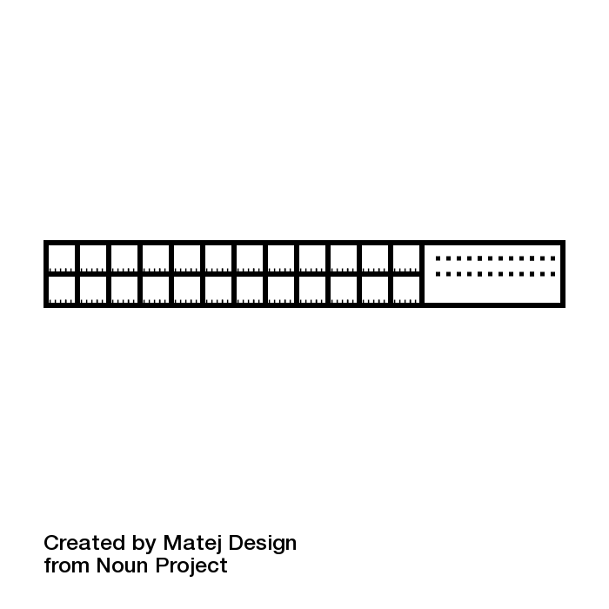



MAC flooding or CAM Overflow
MAC flooding is a technique employed to compromise the security of network switches
UNICAST
PORT | MAC
1 | AB
2 | AC
3 | AD
4 | AE
5 | AF
BRODCAST
Switch look for mac
1
4
PORT | MAC
 | XZX
 | XZ
 | ZXZZ
 | X
 | ZX
Turn into HUB
8
A CAM overflow attack occurs when an attacker connects to a single or multiple switch ports and then runs a tool that mimics the existence of thousands of random MAC addresses on those switch ports. The switch enters these into the CAM table, and eventually the CAM table fills to capacity. When a switch is in this state, no more new MAC addresses can be learned; therefore, the switch starts to flood any traffic from new hosts out of all ports on the switch.
1
4
INVALID MAC ADREESS

Slide 4

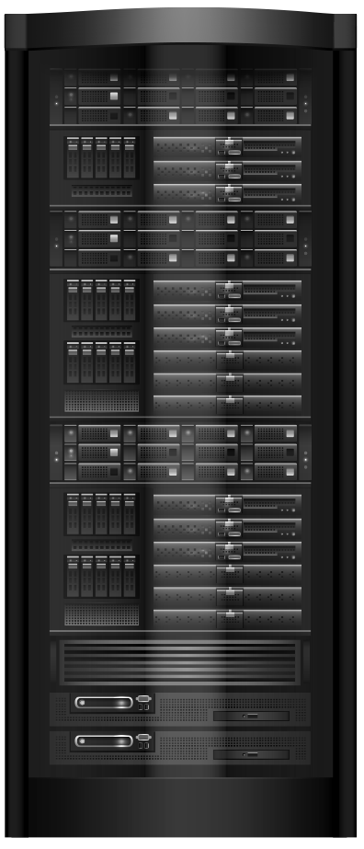
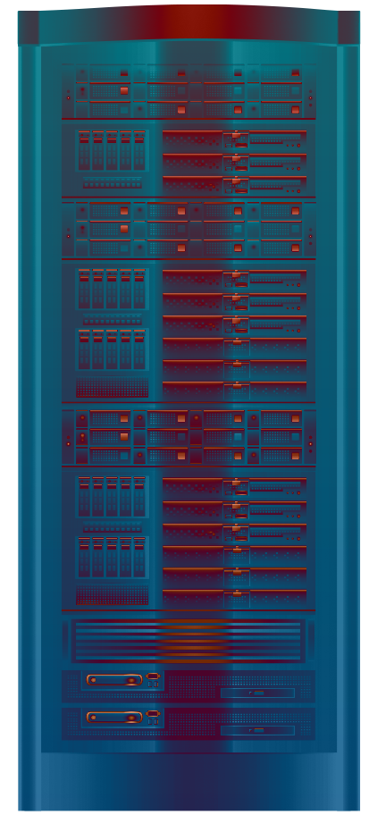





What is a DHCP starvation attack?
The Dynamic Host Configuration Protocol is a network management protocol used on Internet Protocol networks whereby a DHCP server dynamically assigns an IP address and other network configuration parameters to each device on a network so they can communicate with other IP networks.
Renew Leased IP
IP: 192.168.1.1
Removed
Failed to ask for renewal
DHCP
Renew Leased IP
IP: 192.168.1.2
IP: 192.168.1.3
NEW IP 192.168.1.3
An attack that works by broadcasting DHCP requests with spoofed MAC addresses
MITM
A DHCP starvation attack works by broadcasting DHCP requests with spoofed MAC addresses. This is easily achieved with attack tools such as “the gobbler”.
If enough requests are sent, the network attacker can exhaust the address space available to the DHCP servers for a period of time. Network attackers can then set up a rogue DHCP server on their system and respond to new DHCP requests from clients on the network.
Rouge
DHCP
DHCP
YERSINIA

Slide 5



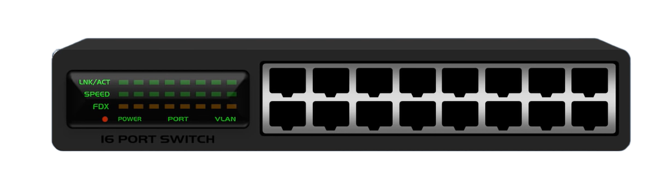



A virtual LAN is any broadcast domain that is partitioned and isolated in a computer network at the data link layer.
LAN 1
LAN 2
in this context virtual refers to a physical object recreated and altered by additional logic.
1 2 3
Logical separation of networks
VLAN
VLAN

